Slide 1

4schools
Adding Profile Information

Slide 2
Follow this link
4 Schools

Slide 3
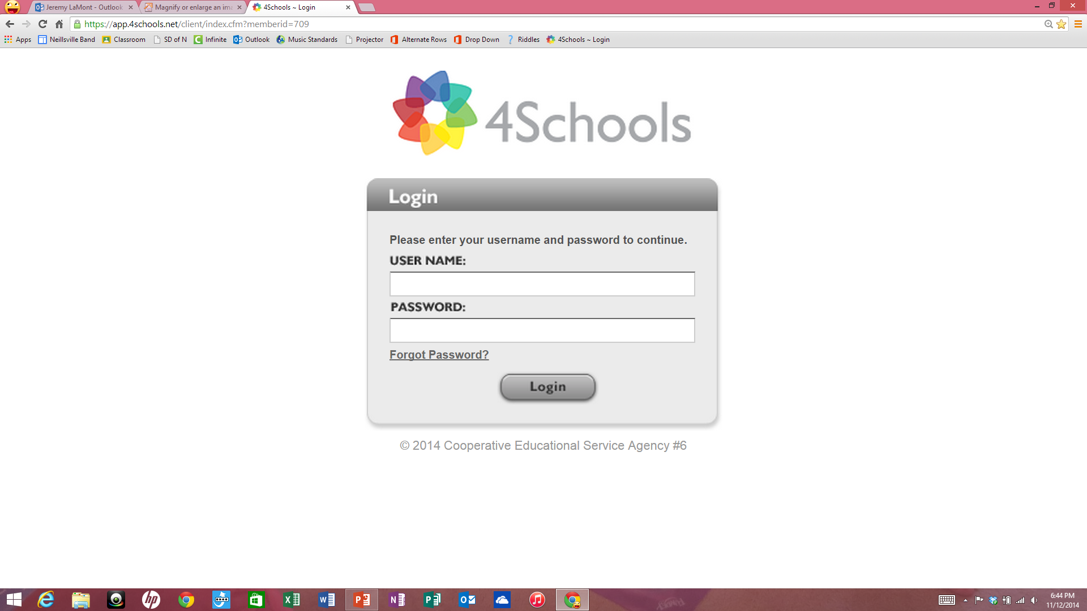
Enter Username and Password
First Initial Last Name
pass1234

Slide 4
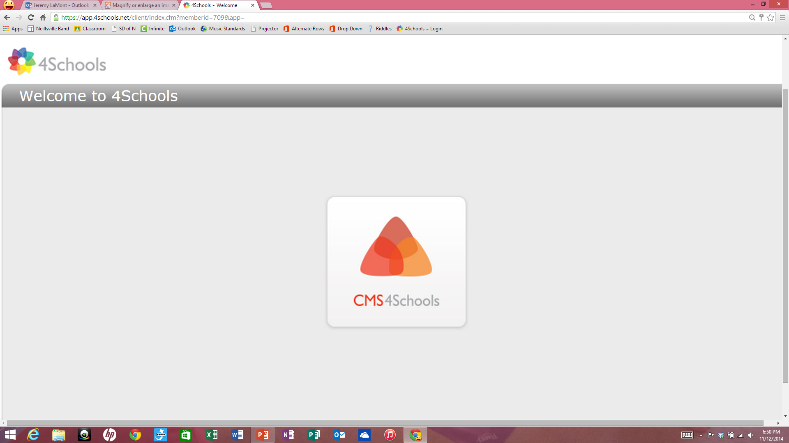
Single Click CMS4Schools icon

Slide 5
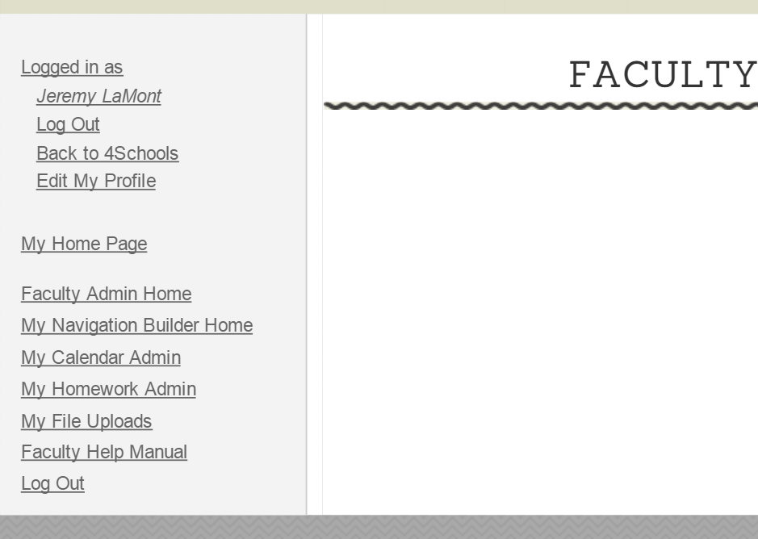
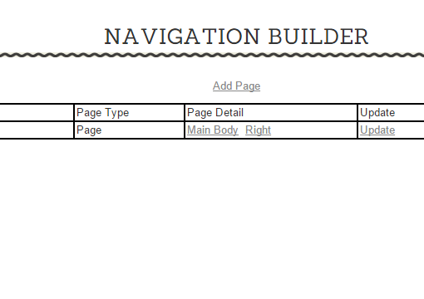
Click My Navigation Builder Home
Click Main Body

Slide 6
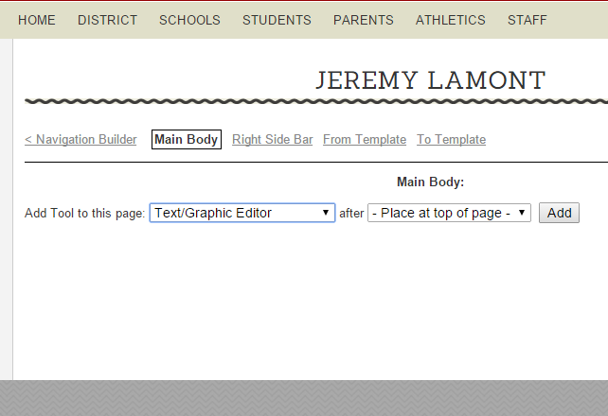
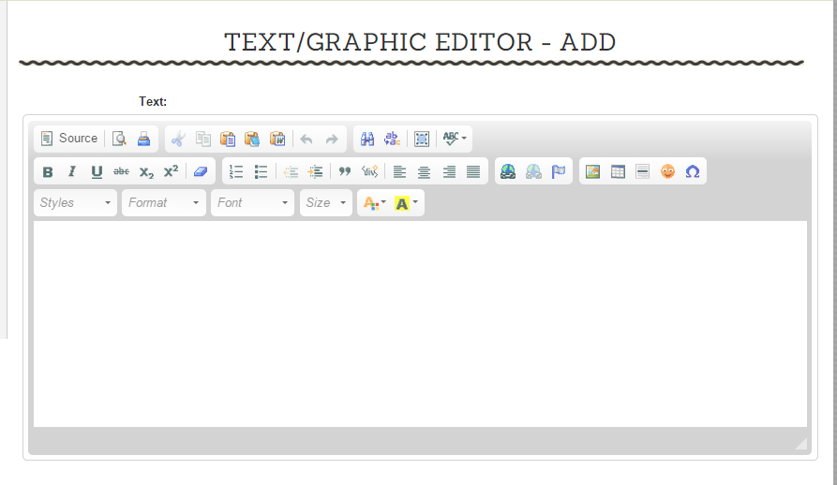
Click Add
Enter Profile Information Here
See next slide for profile guidelines.

Slide 7
Profile guidelines
Name
Background information
What you teach
Where you went to school
When you started to teach in Neillsville
Personal information
Try to avoid using information that needs to be updated each year, i.e. been at Neillsville since 1965 versus been at Neillsville for 49 years
Keep the default text formatting
See next slide for example profile

Slide 8
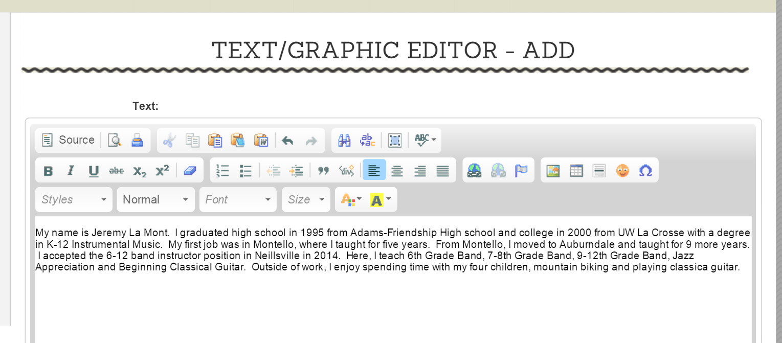
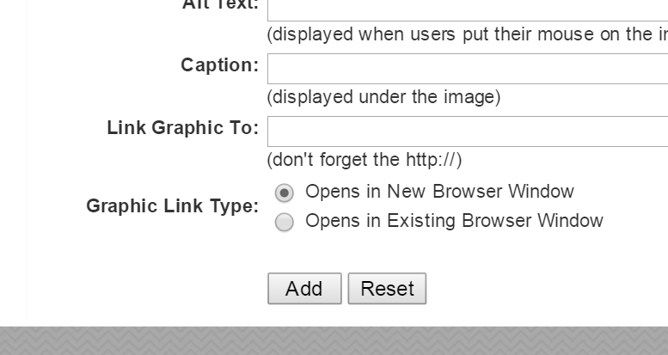
Click Add When Done

Slide 9
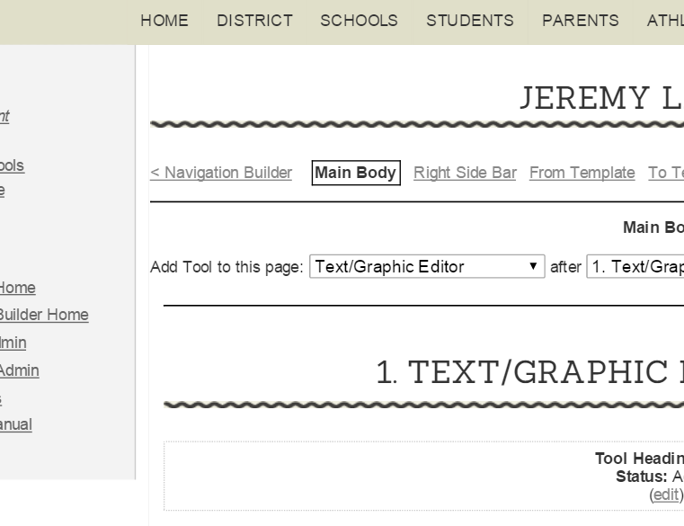
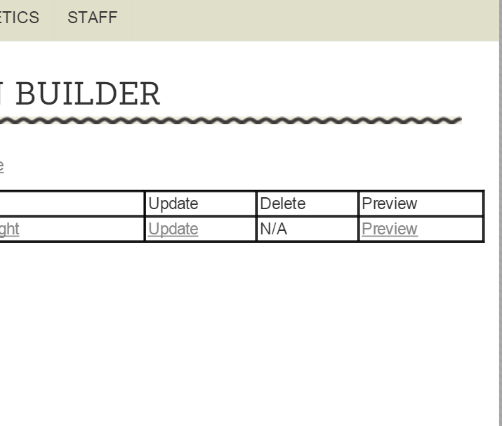
Click Navigation Builder
Click Preview
See Next Slide for Finished Profile

Slide 10
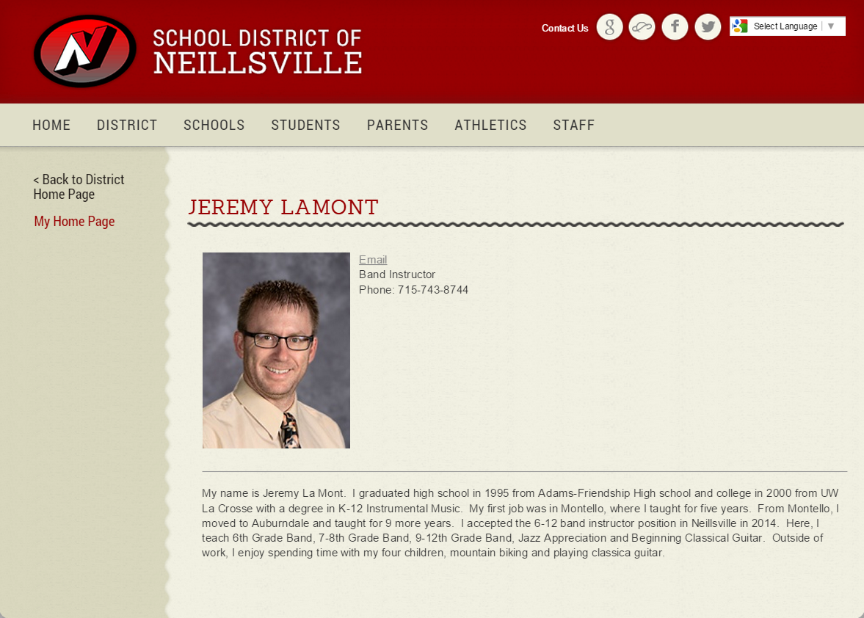
Finished profile
Congratulations!

Slide 11
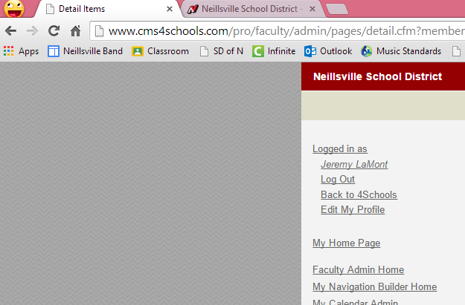
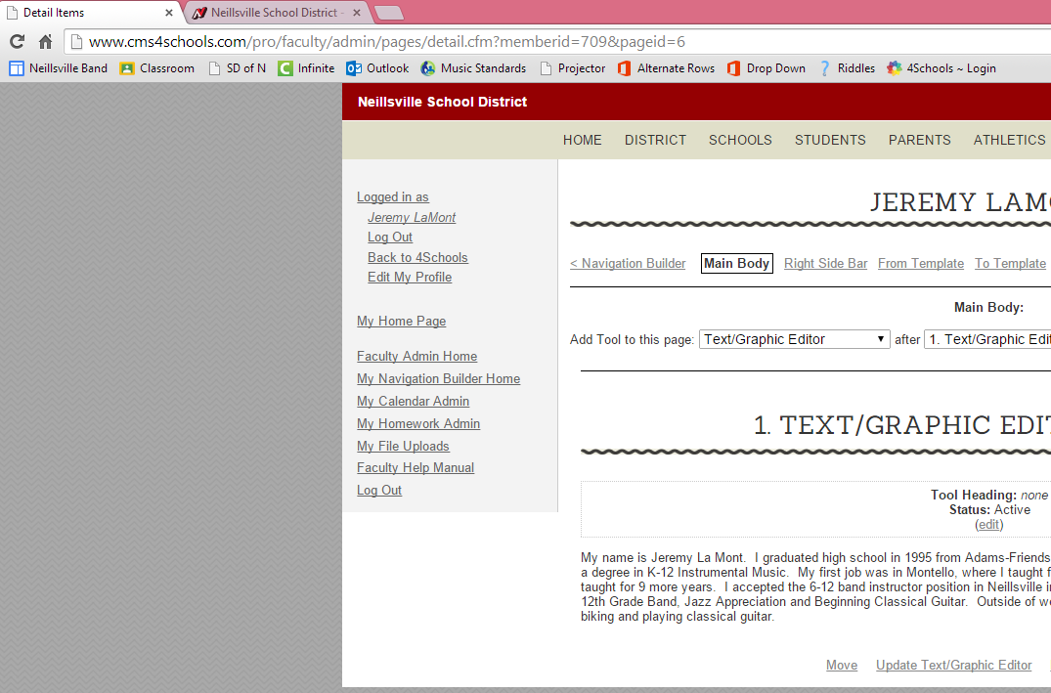
HAPPY?
Not HAPPY?
Click Detail Items Tab
Click Detail Items Tab
Log Out
Click Update Text/Graphic Editor

Slide 12
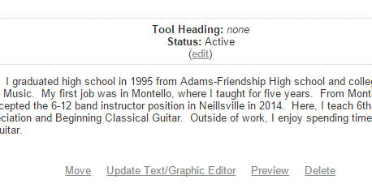
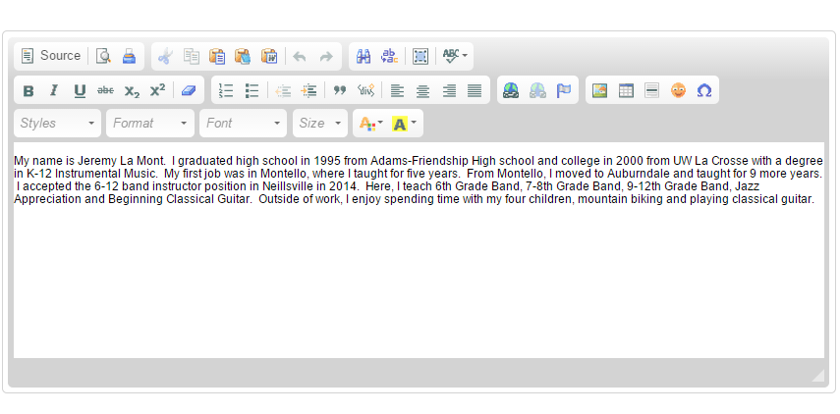
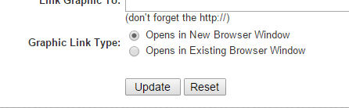
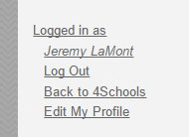
Editing Profile
1. Make corrections here.
3. Click Preview
4. Log Out in Editing Items Tab
2. Click Update

