Slide 1

4Schools
Adding a Web Page

Slide 2
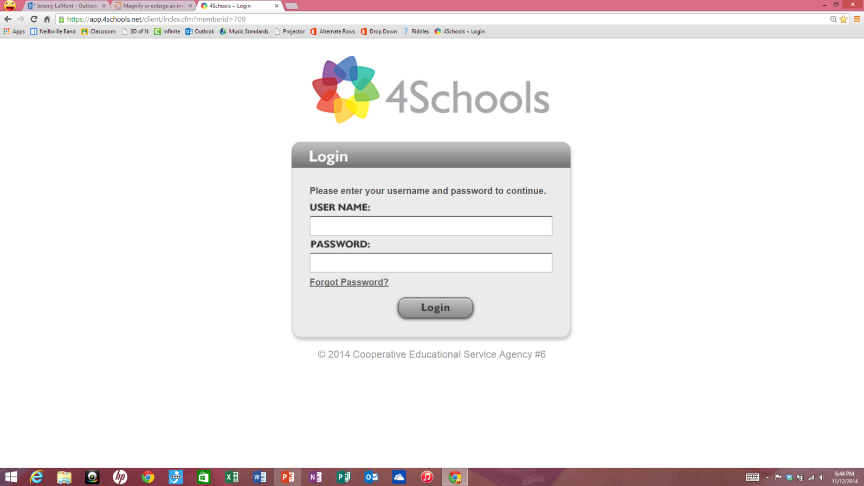
Enter Username and Password
First Initial Last Name
pass1234

Slide 3
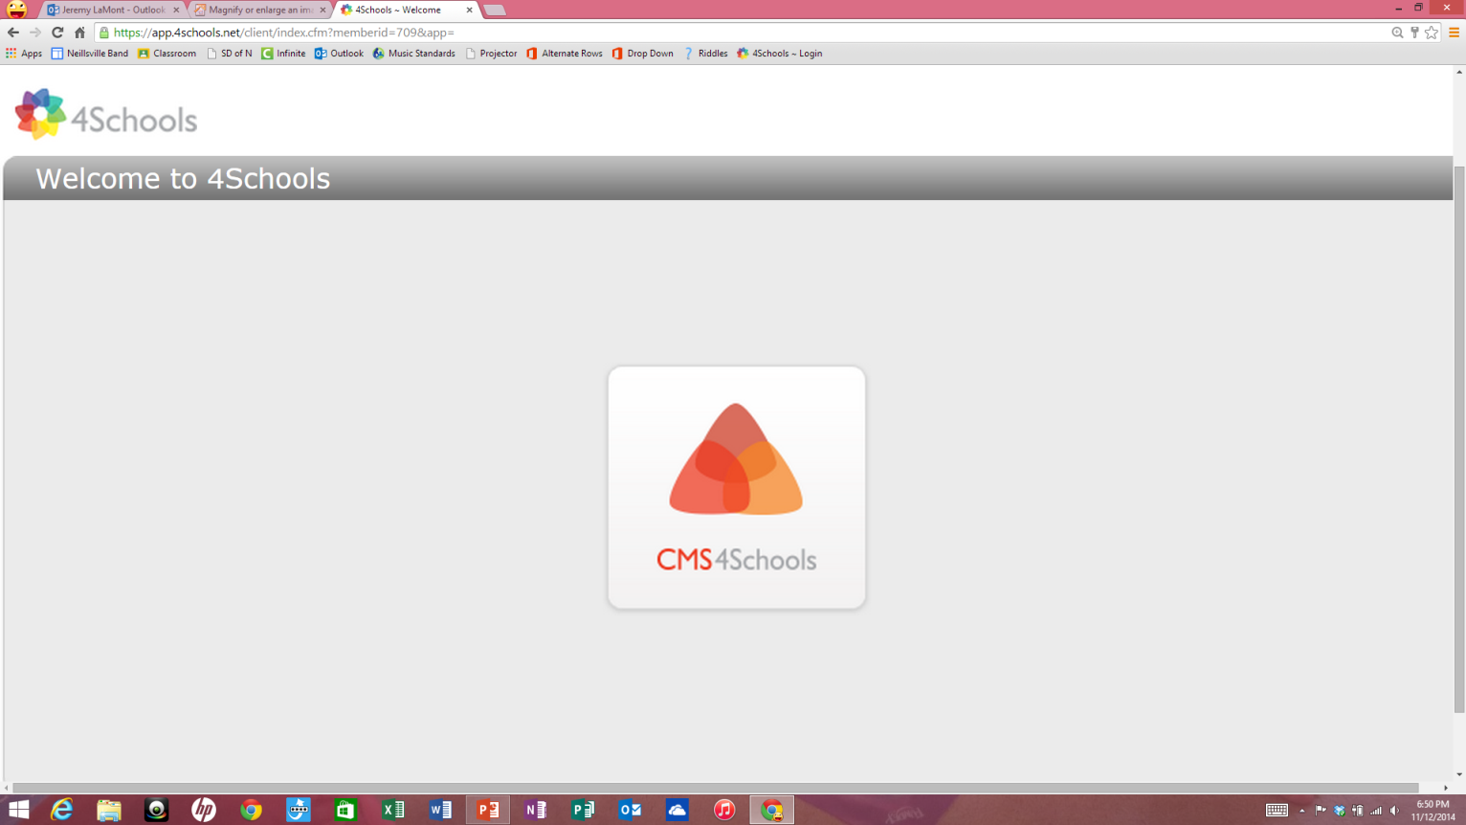
Single Click CMS4Schools icon

Slide 4
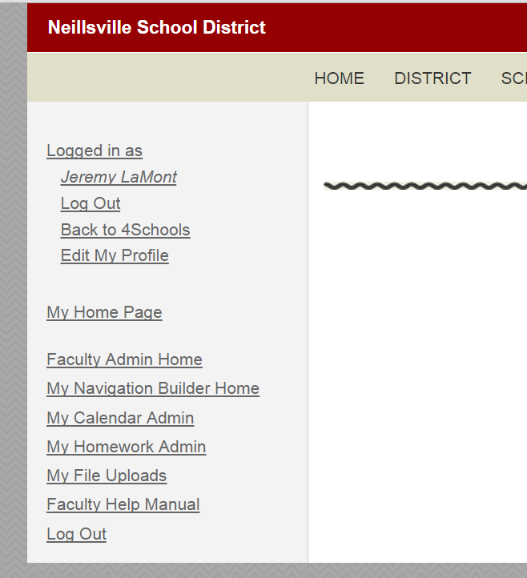
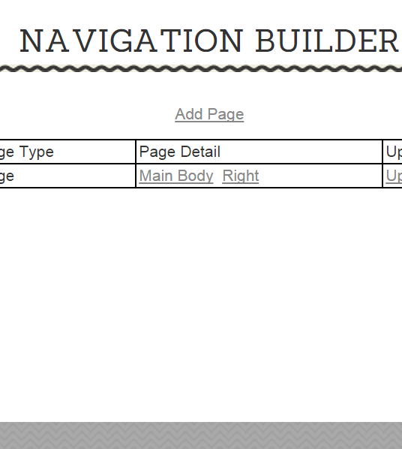
ADDING An internal Web Page
Continue to future slides for:
Adding a web site link
2. Click Here
1. Click Here

Slide 5
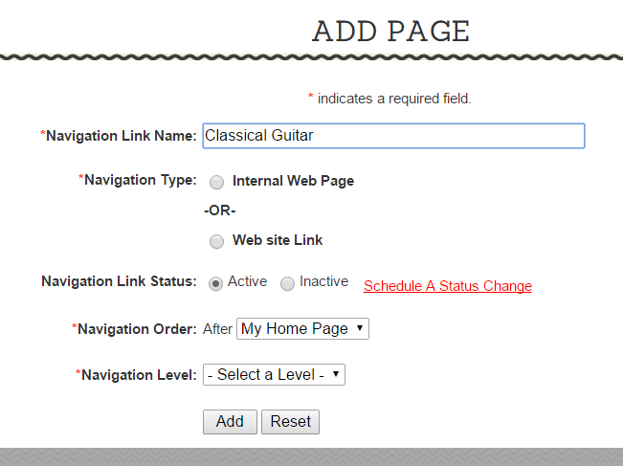
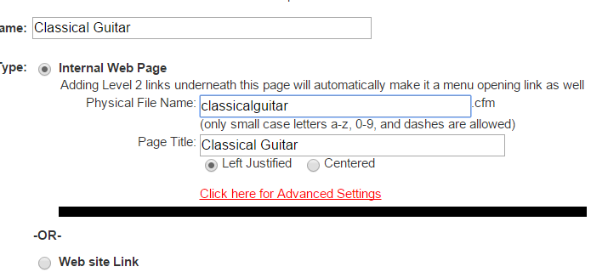

3. Title link.
4. Select Internal Web Page
5. Enter titles.

Slide 6
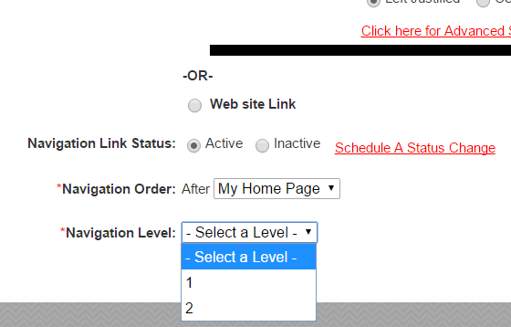
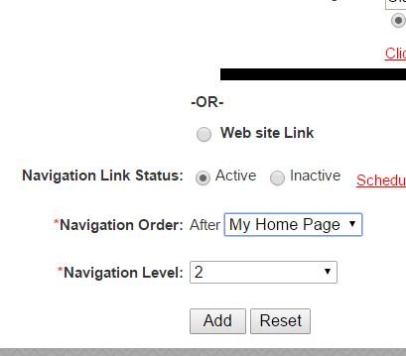
6. Select the order.
7. Select the navigation level.
8. Click Add.

Slide 7
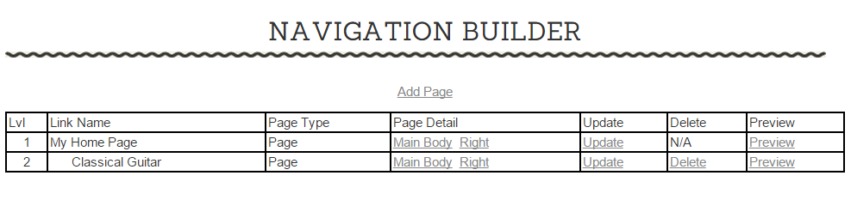

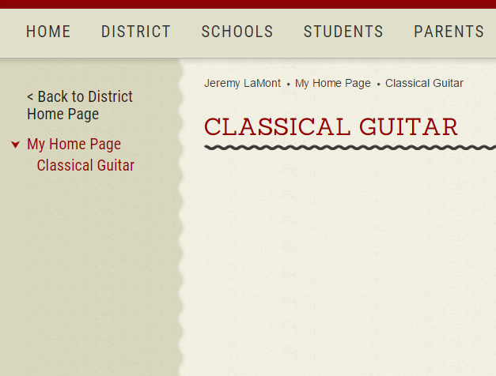
9. Click Preview to see page.
You now have a second page on your site.
Home Page has link to new page.
New Page has links as well.

Slide 8
ADDING A Web site link
2. Click Here
1. Click Here

Slide 9
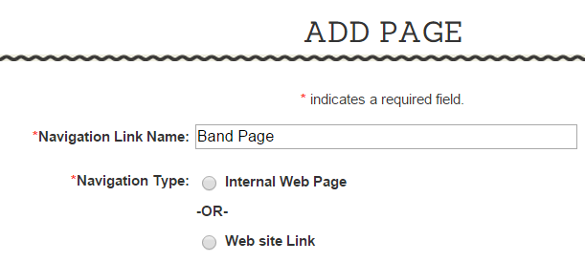
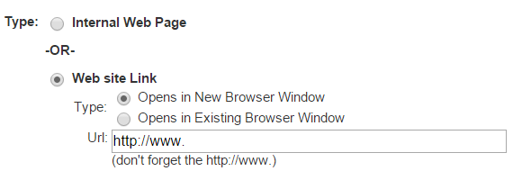
3. Title Page.
4. Select Web site Link.
5. Copy and paste web site link here.

Slide 10
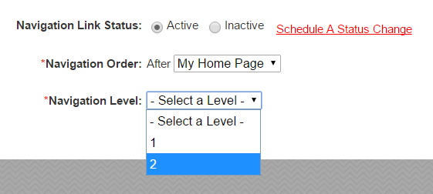
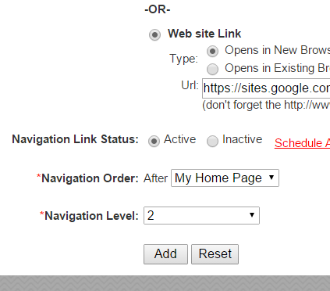
6. Select the order.
7. Select the navigation level.
8. Click Add.

Slide 11
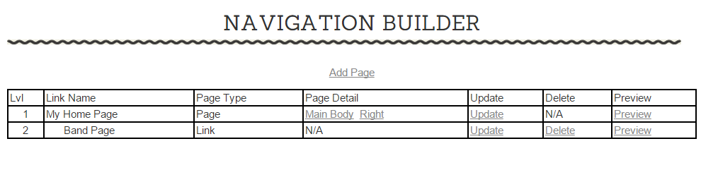
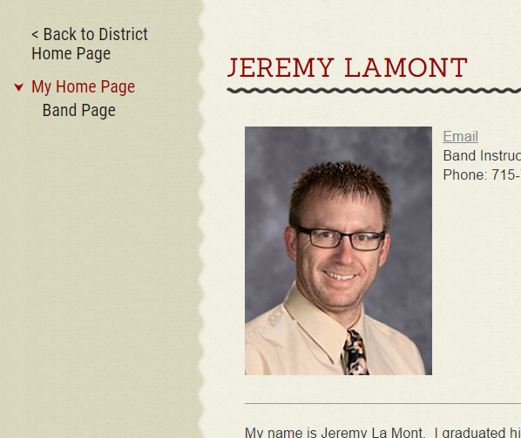
9. Click Preview to see page.
You now have a second page on your site.
Home Page has link to new page.
You’re done!!

