Slide 1

4Schools
Adding a Photo gallery/Slide Show

Slide 2
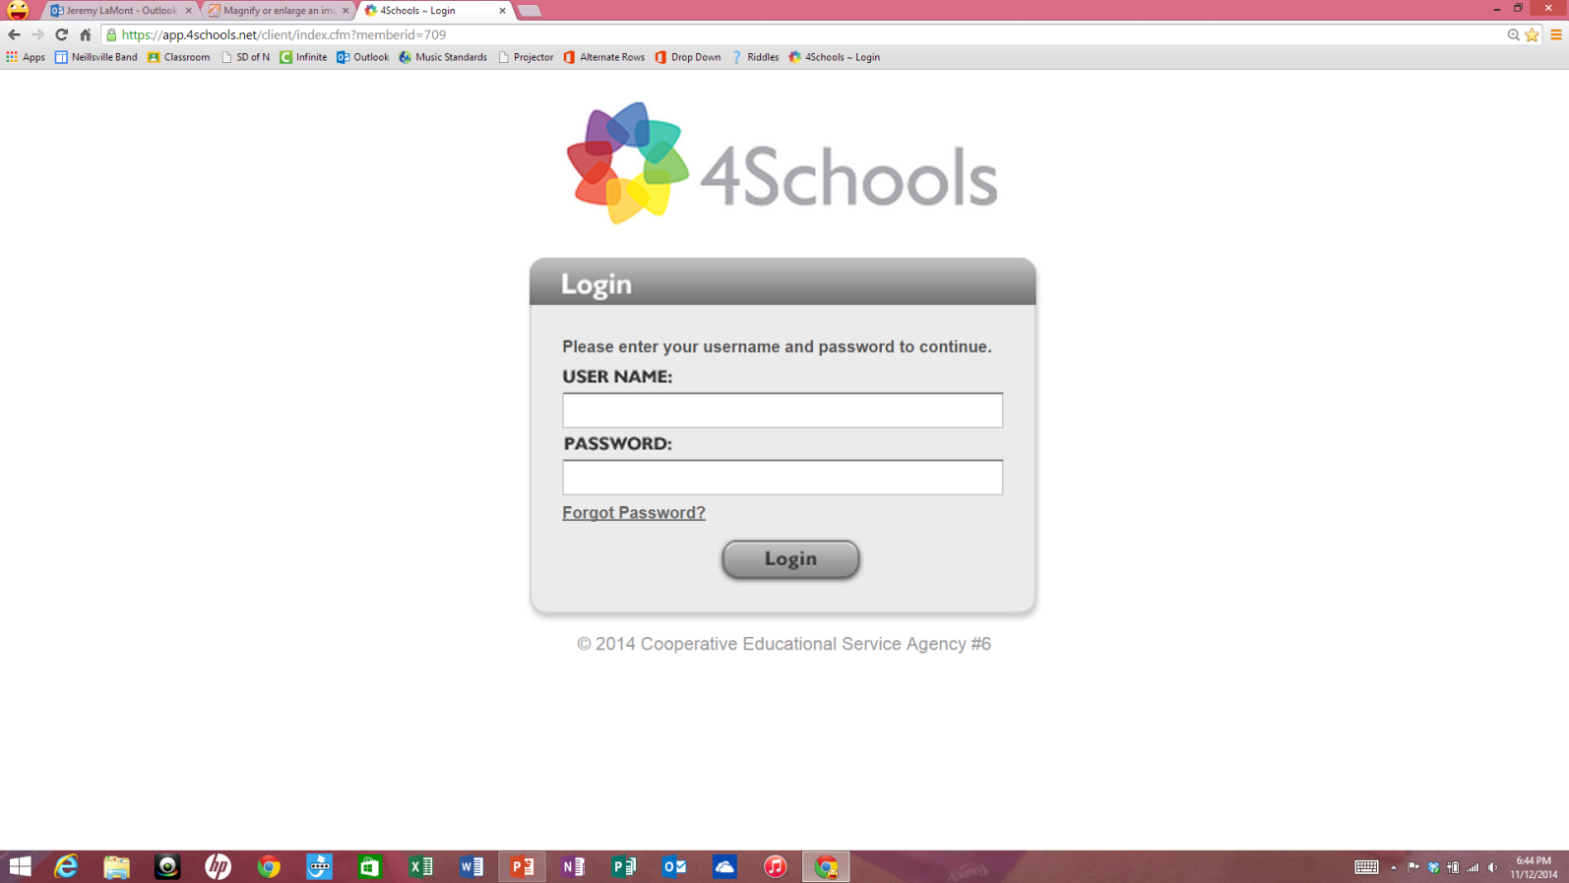
Enter Username and Password
First Initial Last Name
pass1234

Slide 3
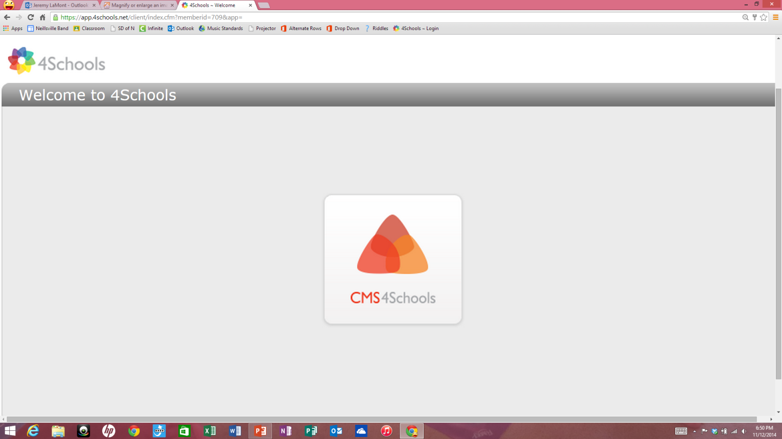
Single Click CMS4Schools icon

Slide 4
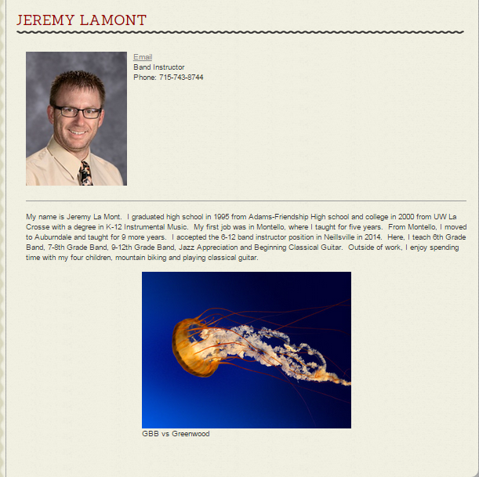
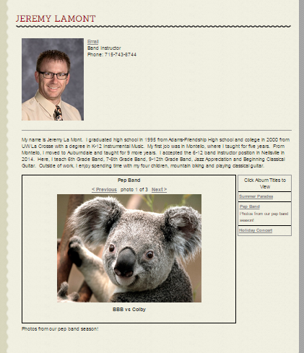
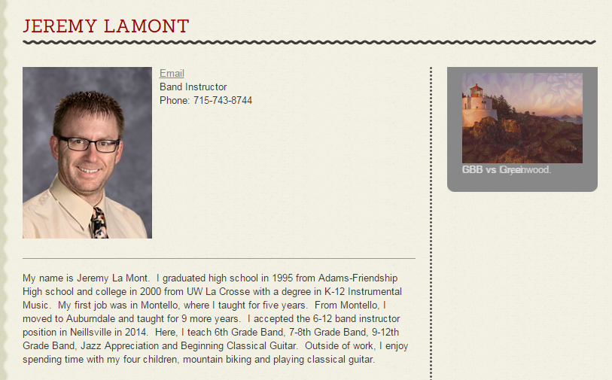
Deside how you want to display your photos.
Slide show on main body.
Photo Gallery w/Albums
Slide show on right side bar.

Slide 5
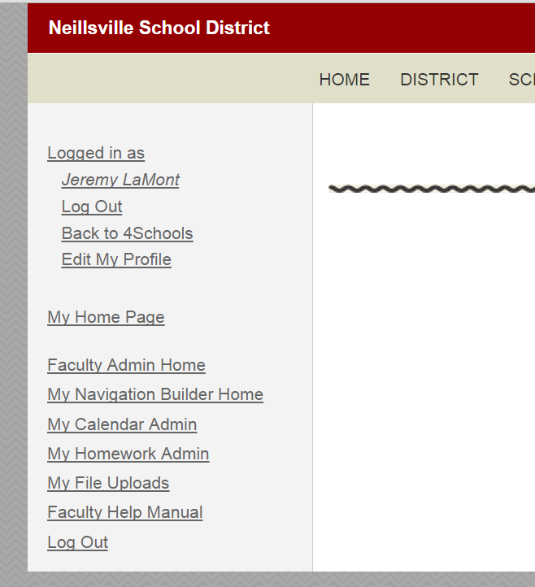
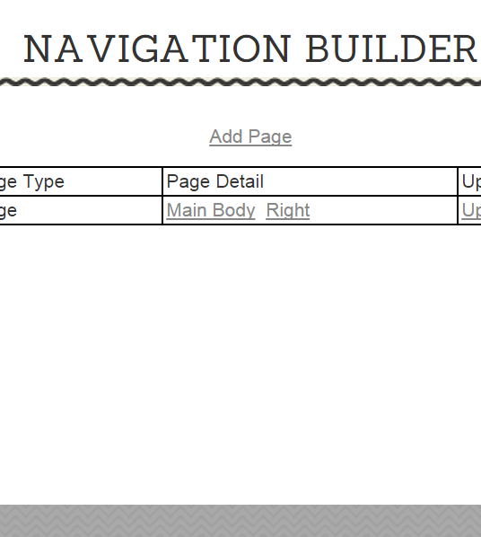
ADDING A photo gallery to the main body
Continue to future slides for:
Adding a slide show to your main body
Adding a slide show to your side bar
1. Click Here
2. Click Here

Slide 6
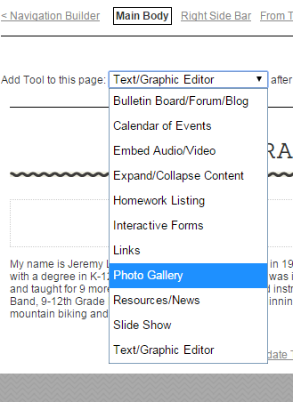
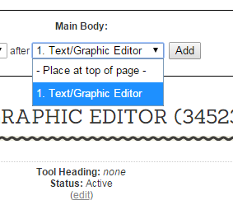
3. Click here.
5. Click here.
7. Click Add.
Select where you want the gallery. I suggest adding it after the Text/Graphic Editor.
4. Select and click Photo Gallery

Slide 7
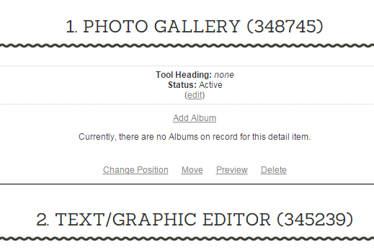
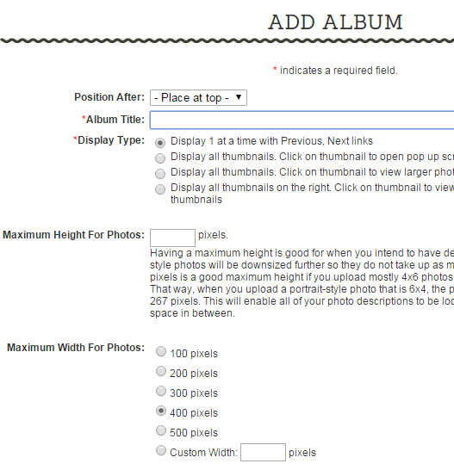
8. Click Add Album
Pep Band
Once you have more than 1 album, select where you want it positioned.
10. Name your album.
11. Select how you want albums displayed.

Slide 8
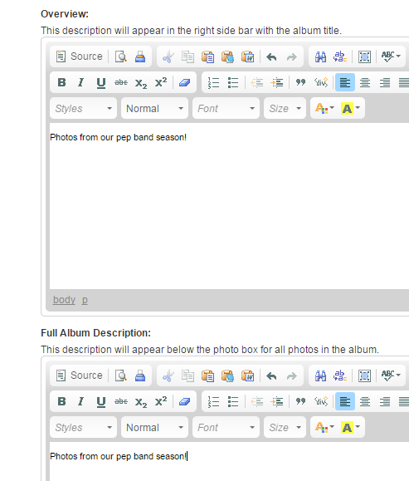
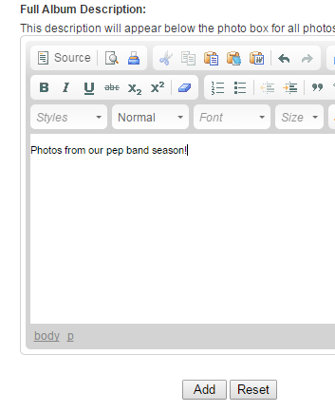
12. Provide an overview and/or description if desired.
13. Click Add.

Slide 9
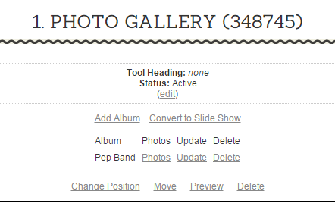
Add more albums by clicking here.
Convert all albums to one slide show by clicking here.
Add photos to your album by clicking Photos.

Slide 10
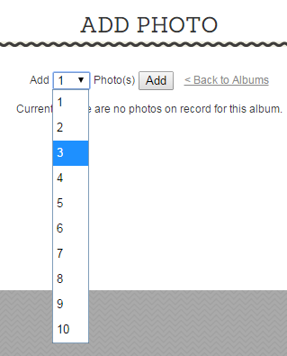
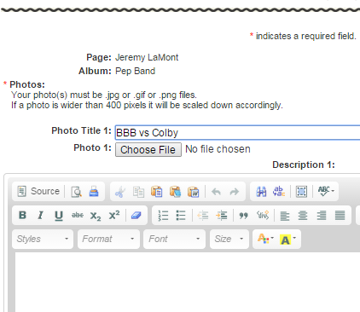
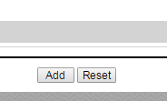
Click here and select how many photos you would like to add.
15. Click Add.
For each photo:
Add a title.
Choose a file.
Add a description if desired.
19. Click Add.

Slide 11
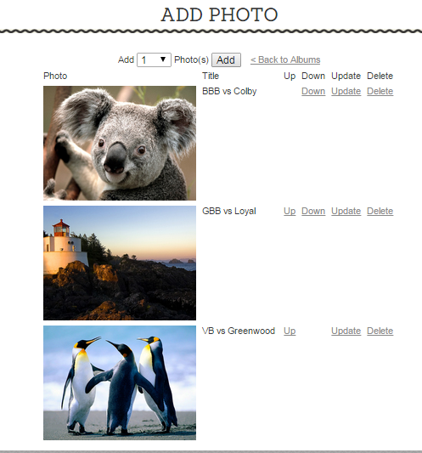
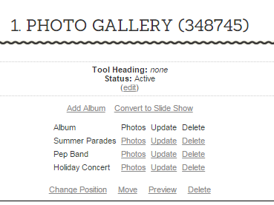
Add more photos here.
20. Click <Back to Albums when finished.
Change order of photos here.
21. Continue to add photos to all albums.
22. Click Preview to see your page.

Slide 12
Users can:
Select an album here.
Navigate your photos here.
Photos are displayed under your profile.

Slide 13
ADDING A Slide show to the main body
Continue to future slides for:
Adding a slide show to your side bar
1. Click Here
2. Click Here

Slide 14
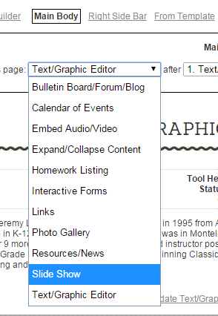

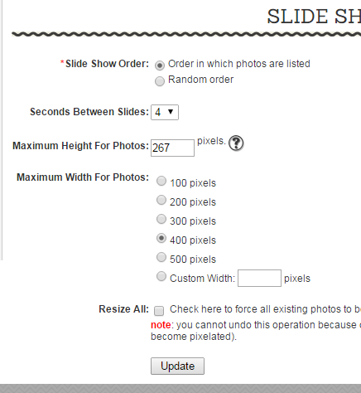
3. Click here.
5. Click Add.
6. Make desired selections.
4. Select Slide Show.
7. Click Update.

Slide 15
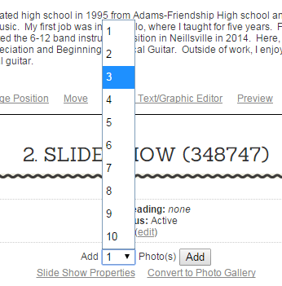
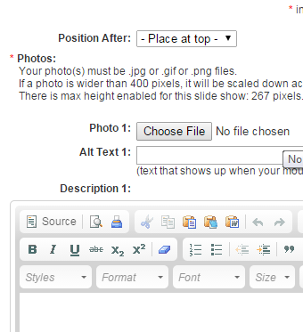

9. Select how many photos you want to add.
10. Click Add.
8. Click here.
For each photo:
Choose a file.
12. Add Alt Text if desired.
13. Add a description if desired.
14. Click Add.

Slide 16
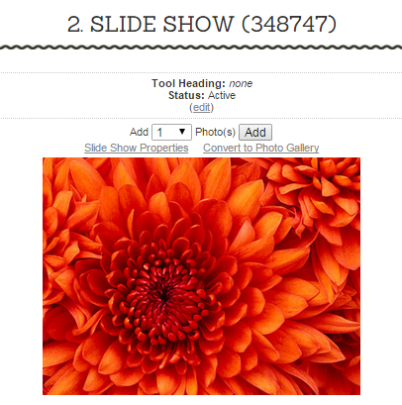
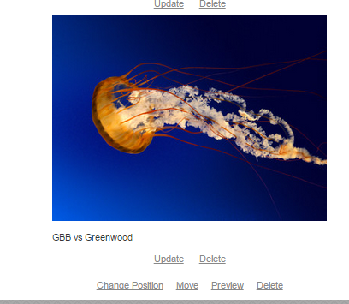
15. Add more photos here.
Convert to a Photo Gallery here if desired.
16. Click Preview to see your page.

Slide 17
Photos display below your profile.

Slide 18
ADDING A Slide show to the Side bar
1. Click Here
2. Click Here

Slide 19
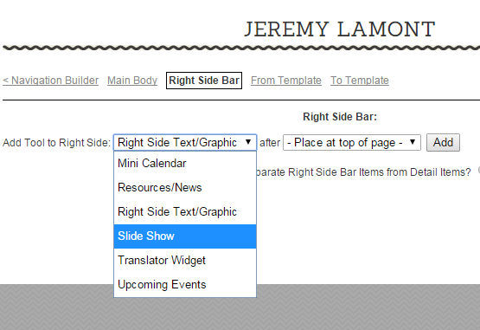
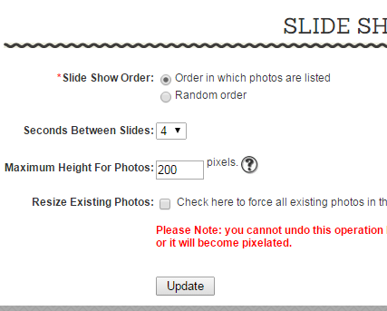
3. Click here.
5. Click Add.
4. Select Slide Show.
Make desired selections.
Click Update.

Slide 20
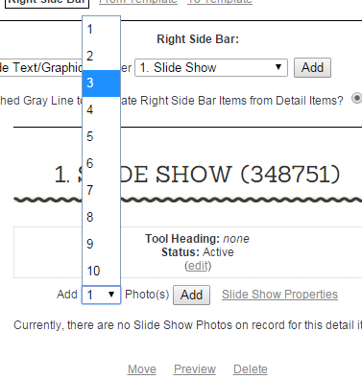
9. Select how many photos you want to add.
10. Click Add.
8. Click here.
Choose a file.
12. Add Alt Text if desired.
13. Add a description if desired.
For each photo:
14. Click Add.

Slide 21
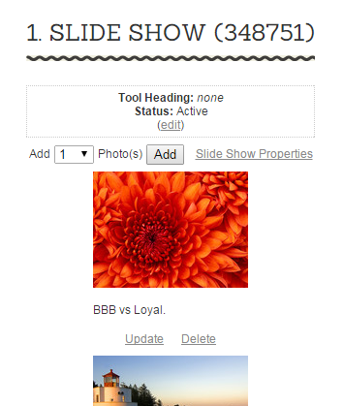
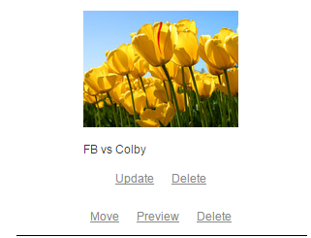
15. Add additional photos here.
16. Click Preview to see your page.

Slide 22
Photos appear on the right of your profile.
You’re done!!

