Slide 1
4Schools
Adding a calendar

Slide 2
Enter Username and Password
First Initial Last Name
pass1234

Slide 3
Single Click CMS4Schools icon

Slide 4
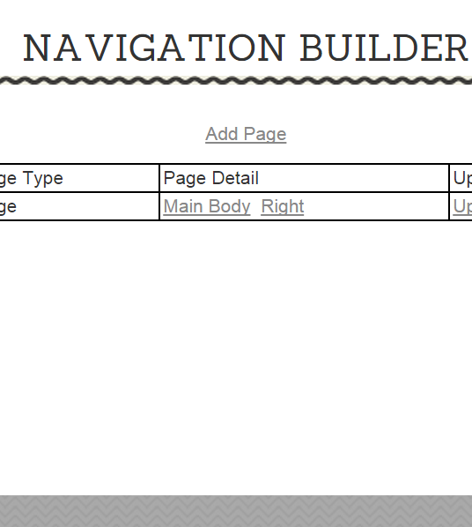
ADDING A Large Calendar
Continue to future slides for:
Small Calendar
Adding events to calendar
1. Click Here
2. Click Here

Slide 5
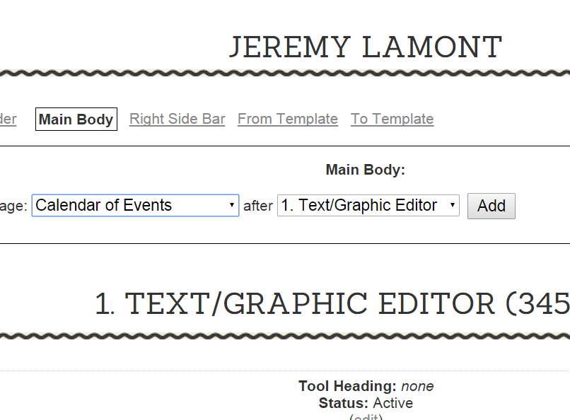
5. Click “Add”
3. Click Here
4. Select and click “Calendar of Events”.

Slide 6
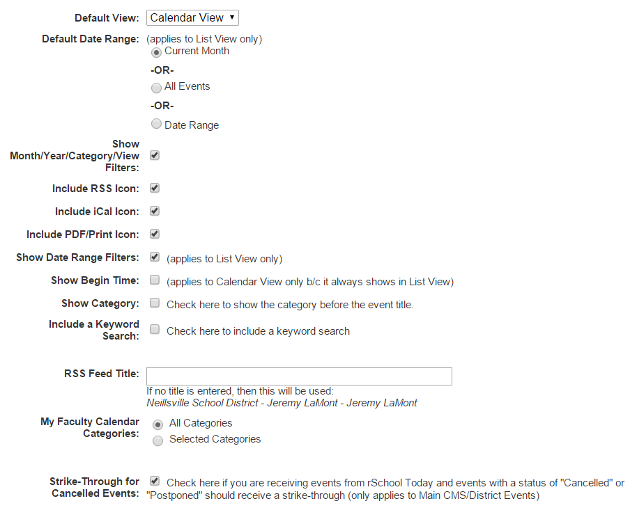
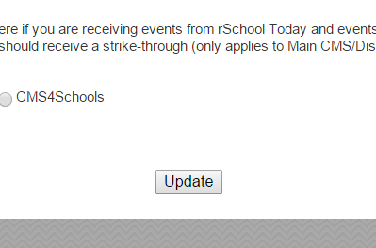
6. Make selections as desired.
7. Click “Update”

Slide 7
You now have a large calendar on your home page.
Continue to future slides for:
Small Calendar
Adding events
Click here to preview your page.

Slide 8
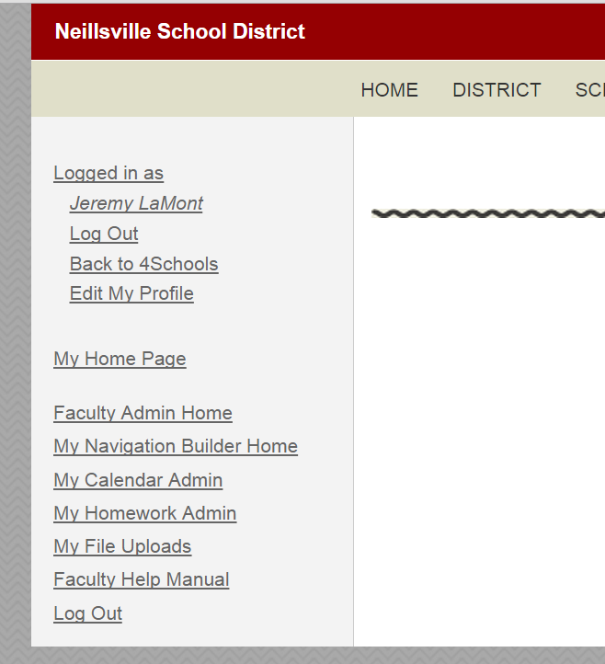
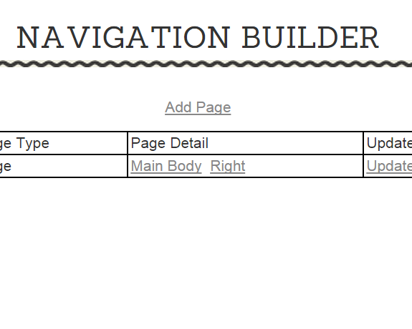
Adding a small calendar
See future slides for:
Adding Events
1. Click Here
2. Click “Right”

Slide 9
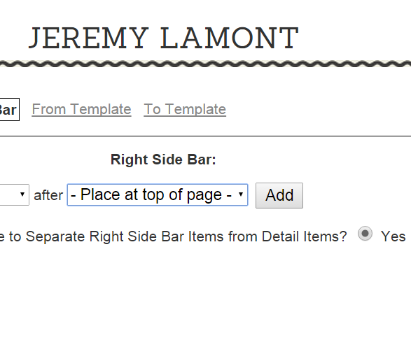
3. Click Here.
5. Click “Add”.
4. Select and click “Mini Calendar”.

Slide 10
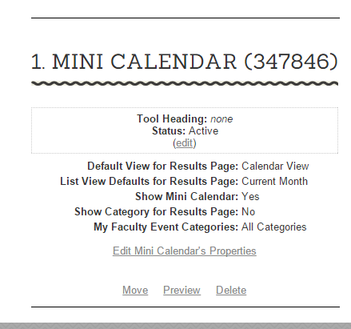
6. Make selections as desired.
You now have a mini calendar.
7. Select “Update”.
8. Click here to preview.

Slide 11
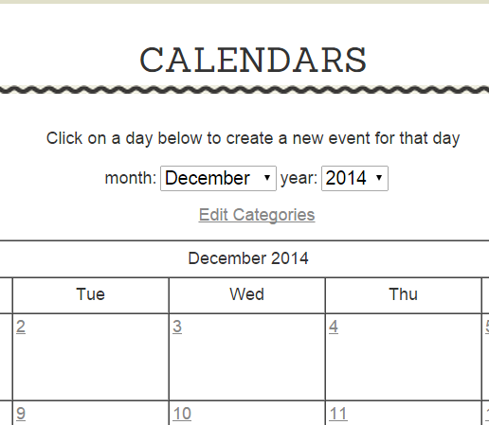
Adding events
2. Click “Edit Categories”.
1. Click Here.

Slide 12
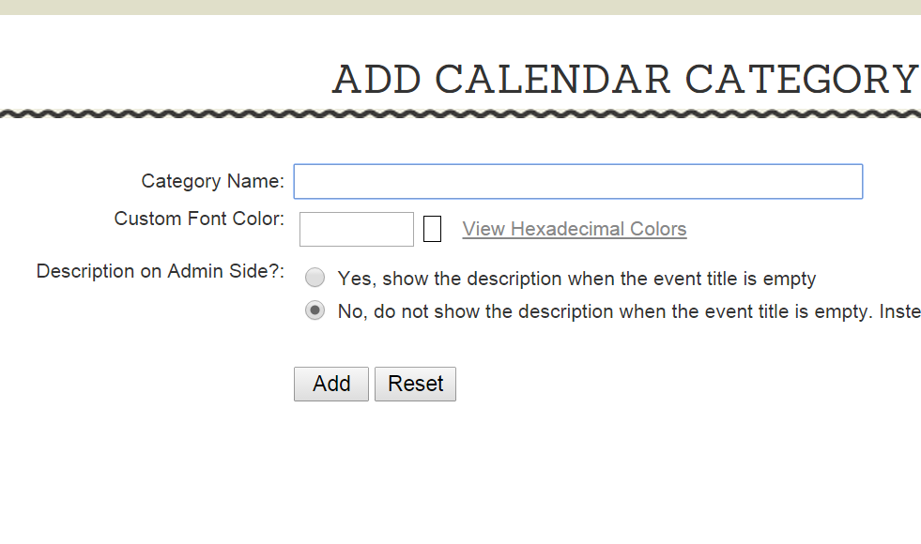
4. Name Category.
3. Click “Add Category”.
5. Make appropriate selections.
6. Click “Add”.
7. Continue to add categories as necessary.

Slide 13
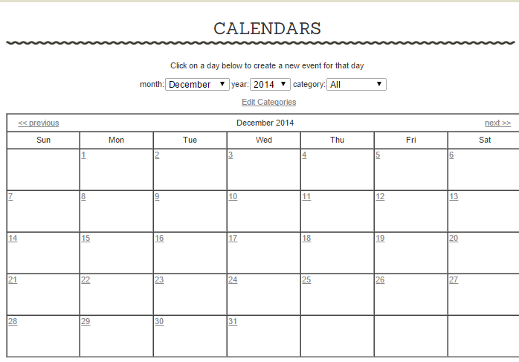
9. Click on a date to add an event.
8. Click “Back to Calendars”.

Slide 14
10. Enter title.
11. Select category.
12. Enter a date description if you want.
13. Enter specific time if you want.
14. Enter an event description if you want.
15. Enter/select an further information you see fit.
16. Click “Submit New Event”.

Slide 15
17. Continue to add events as necessary.
You’re done!!!

